Slide 1
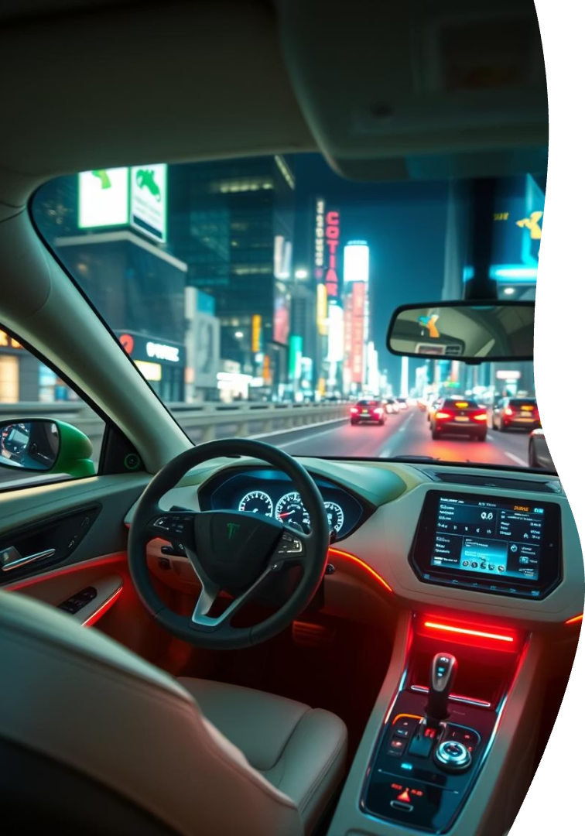

Drivemate: AI-Powered Driving Assistant
Learn to drive the smart way with Drivemate, an innovative AI-powered driving assistant. Developed for Techinertia 3.0 on 21-04-2025, Drivemate offers a structured, accessible, and safe approach to learning how to drive.

Slide 2
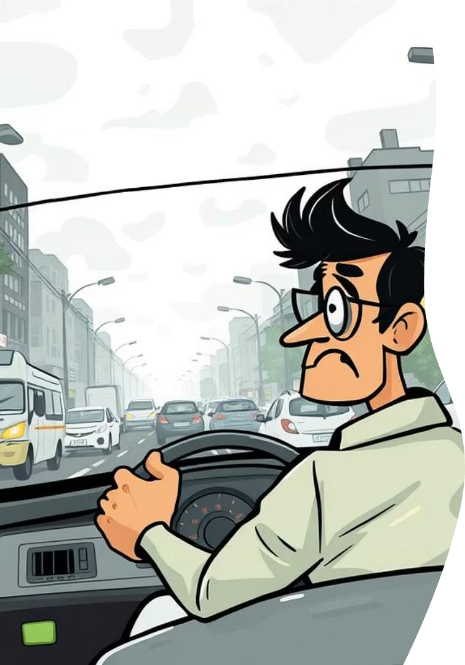




The Problem: Challenges in Driver Education
Lack of Structured Training
Limited Accessibility
Limited availability of instructors and vehicles makes it difficult for many to access training.
Millions struggle with learning driving confidently due to unstructured training methods.
Safety Risks
New drivers face increased safety risks without real-time feedback and guidance.

Slide 3
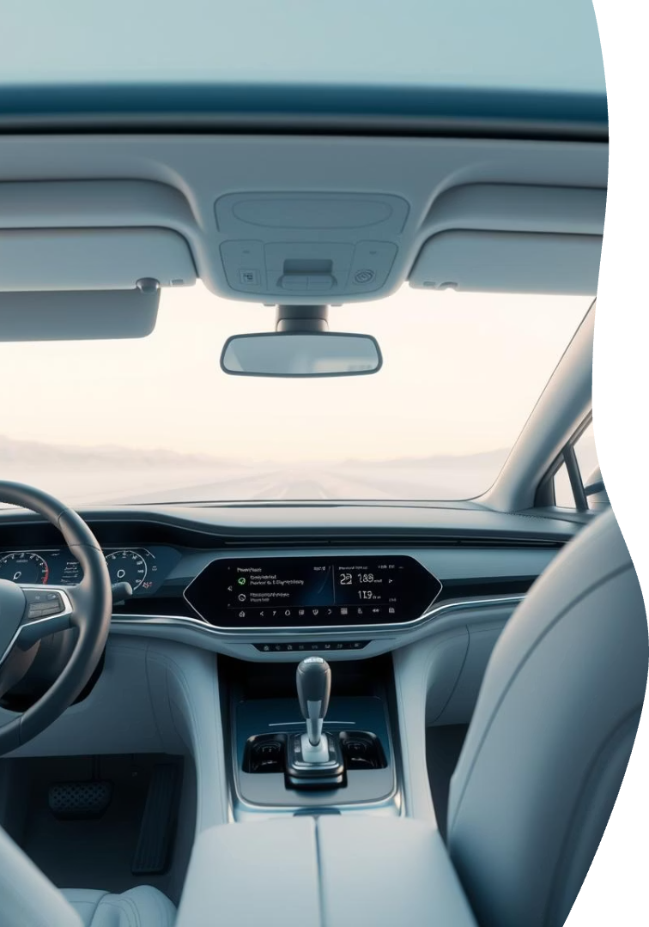



Drivemate: An AI-Powered Solution
AI-Powered Assistant
Guides beginners through level-based learning with AI.
Real-time Feedback
Uses face and road detection for real-time feedback.
Flexible Learning Paths
Supports self-learning and instructor-assisted paths.

Slide 4




Drivemate: Key Features
Level-Based Learning
Dual Camera Detection
Voice Guidance
Eye Movement & Face Direction Tracking
Gyroscope for Steering Alignment
Vehicle & Instructor Booking
Simulated License Registration

Slide 5
Drivemate: Technology Stack
Frontend
AI/ML
Backend
Mobile Plan
React / HTML5 + JS (webcam, mic access)
MediaPipe / OpenCV for face & eye detection
Firebase / Node.js (mock DB)
React Native or Flutter (optional)

Slide 6




Drivemate: System Architecture
User Interface
1
Real-time AI Detection
2
Government Integration (Mock)
4
3
Backend Progress Tracking
The system enables seamless interaction between the user, AI, and backend services.

Slide 7
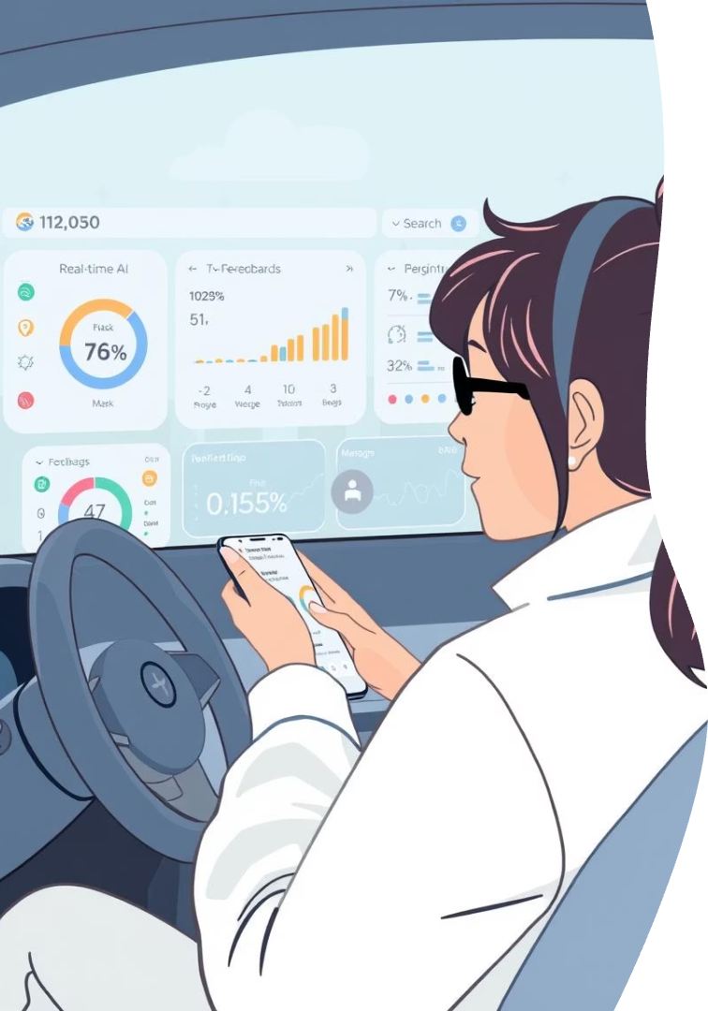
Drivemate: Live Demo
Webcam Face Detection
Dashboard with Levels
Voice Instruction Trigger
Observe Drivemate in action, showcasing real-time AI feedback and progress tracking.

Slide 8



Drivemate: Impact & Uniqueness
Scalable Education
Safe Driving
Accessibility
Drivemate makes driving education scalable, smart, and accessible. It encourages safe and responsible driving habits.

Slide 9




Drivemate: Future Roadmap
Mobile App Release
Real-World Data Integration
Govt API Collaboration
Advanced AI models for fatigue detection and AR/VR training simulation are planned.

Slide 10

Thank You!
Drivemate is paving the way for a new era of efficient, safe, and accessible driver education.
1
Revolutionary Solution
2
Advanced Technology
Addresses key challenges in driver education.
Utilizes AI for personalized, real-time feedback.
3
Future Ready
Scalable platform for continuous innovation.

